Slide 2
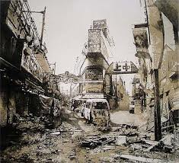
Chapter 1
The book begins with Katniss going back to district 12, despite what the authorities of district 13 think, to see the remains of the city and the home she once shared with her family. During her visit she finds Prims cat that somehow survived all the bombings and a rose from President Snow on her dresser.

Slide 3
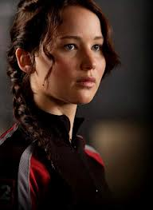
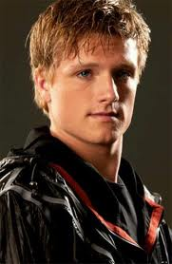
Chapter 2
There's a lot that happens in this chapter. In the beginning its about how Katniss is adjusting to district 13. The focus moves to Peeta when he does a live interview with Caesar. Katniss learns he's alive, healthy, and hasn’t been tortured and that is when she decides to be the Mocking Jay, the face of the rebellion!

Slide 4
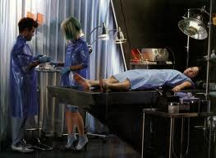
Chapter 3
Katniss tells the President of District 13 that she has decided to be the Mocking Jay and gives her list of “wants” or things she demands to have while she is the Mocking Jay. For example Peeta’s safety when they win the war. She also learns her responsibilities as the Mocking Jay. At the end of the chapter Katniss finds that her prep team has been held prisoner the hole time she's been in 13.

Slide 5
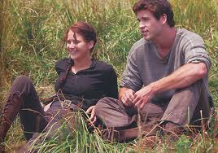
Chapter 4
Katniss saves her prep team and takes them to her mother to restore there health. She gets permission to go hunting with gale for the first time in 9 months. Then she attends a public reading of the promises made to her in return for being the Mocking Jay.

Slide 6
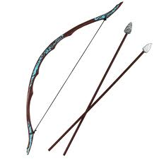
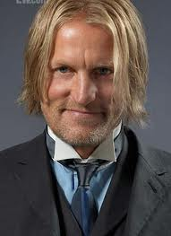
Chapter 5
In this chapter the prep- team starts to return Katniss to beauty base zero(basically a flawless body with no make up on). She receives a new bow from Beete. She also starts to shoot the footage for the commercials when she hears Haymitches voice for the first time since she clawed his face in book two!

Slide 7
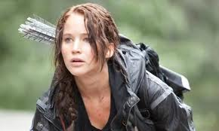
Chapter 6
In this chapter Katniss and all the Government officials decide they will shoot the commercials in the combat zone. She also decides to trust Haymitch again after he lied to her about the rebellion.

Slide 8
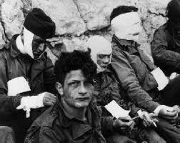
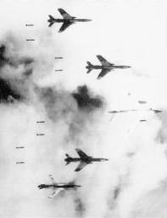
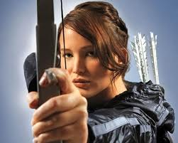
Chapter 7
Katniss goes to visit the wounded in district 8 when she finds her self in the middle of an air raid from the capitols bomb squad. When she sees there targeting the hospital she starts to fight back. After her, Gale, and the rest of the armed rebels take out the last of the planes Katniss tells Snow that if the rebels burn he's burning with them!

Slide 9
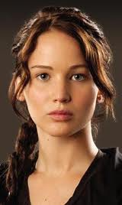
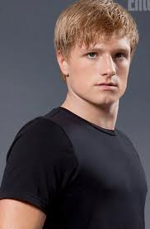
Chapter 8
Katniss is in the process of healing her after she hurt her leg in 8. In addition the commercial she shot in 8 are playing all over the country and everyone is coming up with some ideas for other commercials. She also see’s Peeta again on the television.

Slide 10
Chapter 9
Katniss and Gale go back to district 12 to do a commercial in this chapter. This is very hard on every one but Katniss and Gale have each other so every thing is okay, until Peeta makes yet another speech on why there should be a cease-fire. He then tells Katniss everyone in 13 will be dead by morning and is beaten bloody on live television.

Slide 11
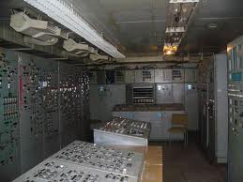
Chapter 10
After Peeta makes his speech on live TV, the president of 13, Coin, sent the entire population into the lower levels bunkers, just in case Peeta was giving them a warning. The capitol started bombing district 13 that night but thanks to Peeta no one was hurt!

Slide 12
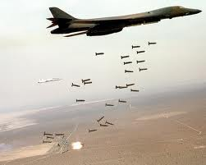
Chapter 11
Through out this chapter the capitol drops more bombs on 13. Coin also decides to send in a rescue team to save Peeta and the other victor that are trapped in the president’s house.

Slide 13
Chapter 12
This is the chapter when the rescue mission begins. In order to distract President Snow away from the prisoners and to the T.V., Katniss does an interview on how she met Peeta and Finnick . She also talked about how Snow forced him to sell his body to the women in the capitol. Thee distraction worked and they rescued everyone! But when Peeta saw Katniss for the first time he choked her instead of hugging her.

Slide 14
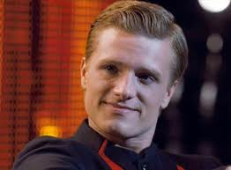
Chapter 13
Beete figures out that Peeta was highjacked, a method of torture that messes with your memory, and he immediately begins rehabilitation on him. Katniss also decides to go to district 2.

Slide 15
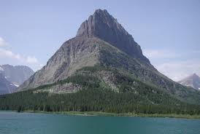
Chapter 14
Meanwhile in district 2, Katniss, Gale and the rest of the rebels figure out how to take down the Nut which is a large mountain that serves as a military base of sorts for the capital.

Slide 16
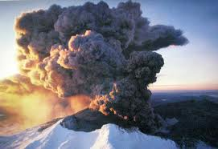
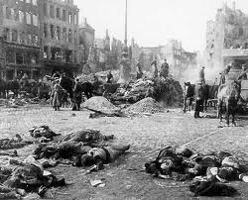
Chapter 15
The rebels put there plane to work and work it does. They manage to bring down the nut. But then the Peace Keepers come and start the fighting. Haymitch instructs Katniss to give a speech to try to stop the fighting because the rebels already won. When she is done with her speech she is shot and the same time the bullet makes contact with her she looks up at the screen, so she watches her self being shot.

Slide 17
Chapter 16
Finnick gets married to Annie his lover from district 4. Peeta decides to talk to Katniss again after he tried to kill her after he was convinced she was an evil mut, a hybrid species made by the capitol. So Katniss agrees but it proves to be harder than she expected.

Slide 18
Chapter 17
Katniss finds out she wont be aloud to go to the capitol to help bring it down unless she goes to training. So she does and so far she’s doing pretty good job to.

Slide 19
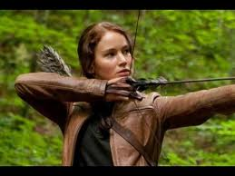
Chapter 18
Katniss passes her “final exam” in training and is recruited to a special shot team. This team is lead by Boggs the only friend she has made in 13. Then her, her team, and Peeta were sent into to war.

Slide 20
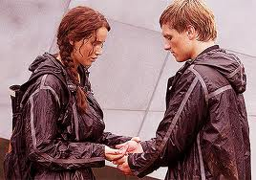
Chapter 19
This chapter is basically about the rehabilitation of Peeta and his relationship with Katniss. They make up a game called real or not real were Peeta can ask any thing he wants and they respond with real or not real. Katniss also learns that the president of 13 wants her dead. That’s why the president sent Peeta along. She thought he would kill her out of anger.

Slide 21
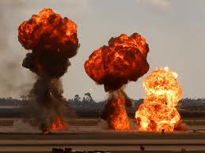
Chapter 20
Boggs leads his crew out into the streets in an attempt to make it to the capitol. But when they make a wrong turn some where along the way and trigger a field of bombs. Boggs dies and tells Katniss she is in charge. Boggs also told Katniss to kill Peeta. Peeta goes crazy again and pushes someone triggering another bomb. The person he pushed was killed and now Peeta wants to be killed him self out of guilt.

Slide 22
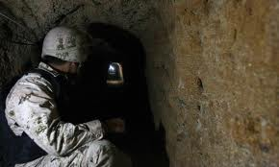
Chapter 21
They continue there journey to the capitol only this time under ground not above ground. They find it to be much safer until they wake up to hissing but not regular hissing like… Katnissssssss. Like saying Katniss but holding the “s” out.

Slide 23
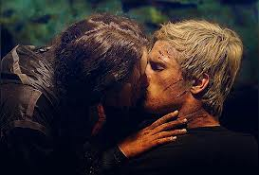
Chapter 22
In the mist of trying to get away from the mutts, they loose Finnick and one other man. They make it back to safety and Peeta and Katniss share there first kiss since the second games.

Slide 24
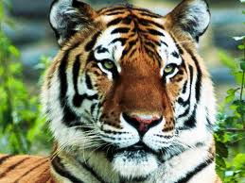
Chapter23
Mixed with
They meet a women named Tigris who has gotten reconstructed to look half tiger. She hides them in the basement of her store for a few days.

Slide 25
Chapter 24
Katniss, Gale , Peeta , and the others make a plan to head into town so they can try to kill Snow and end this whole thing. They start there plan, Gale is taken by peace keepers, Peeta is no where to be seen and Prim is tending to a group of children that had just been bombed.

Slide 26
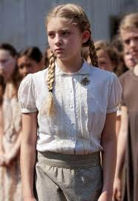
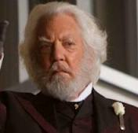
Chapter 25
In the second round of bombing prim is hit and killed, Katniss and Peeta are both badly burned. While Gale was trying to get away he was shot twice but recovered pretty fast. Once back to health Katniss begins roaming around the mansion and runs into president snow who tells her it was Coin who dropped the bombs that killed her sister not him.

Slide 27
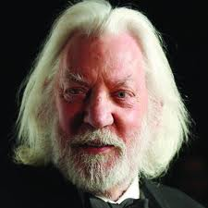
Chapter 26
Katniss, Haymitch, Coin, and all the other victors vote to have a hunger games just for the capitols children. When its time to shoot Snow, Katniss Shoots Coin instead and on purpose.

Slide 28
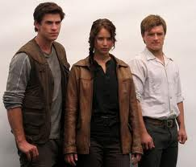
Chapter 27
Finally things get better. There are no more hunger games. Gale has a job in district 2 and Peeta and Katniss slowly become one again. Katniss also gets better over time and she begins hunting again.

Slide 29
Suzanne Collins
Suzanne was born August 10th 1962. She started writing in 1991 for a children's show. The Hunger Games is the first trilogy she has ever written.

Slide 30
The
End

